Slide 1
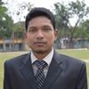
The " Stay home, Stay safe" thing to do.
Our idea proposal presentation
Md.Abdullah Al Mahmud
Chief Exicutive Marketing Officer at JBD IT

Slide 2
Description: "Corona virus" is pandemic in the world. At present, the virus has started to spread in Bangladesh. Meanwhile, the health department of the government has declared Bangladesh as "dangerous" in the corona virus. In this regard, the Honorable Prime Minister of Bangladesh 'Sheikh Hasina' has directed to maintain the social distance of the people of the country. The government has given strict guidance to the law enforcers to maintain social distance in addition to ordinary holidays. Various regions of the country have already been declared 'lockdown'. Nevertheless, law enforcement agencies are trying to keep ordinary people at home. The reason for this is that people are going out of their homes to buy their essential commodities, medicines and so on. In some cases, all these people are leaving home. As a result, it is not possible to maintain social distance. Now our biggest challenge is to keep people at home.

Slide 3
Step 1:
First, the ward based data center and call center should be started. And the residents of the ward have to be informed about this through the media.

Slide 4
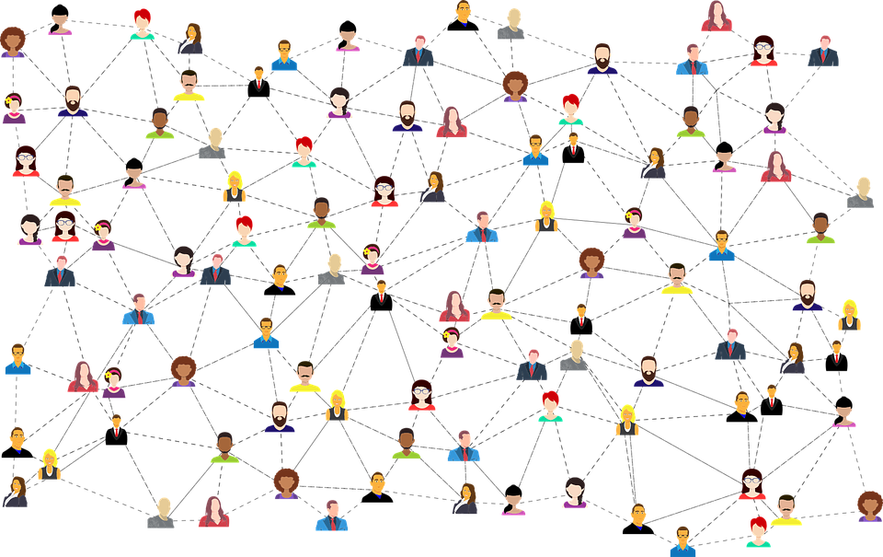
Step 2:
The number of families in the ward should be calculated through the call center.

Slide 5
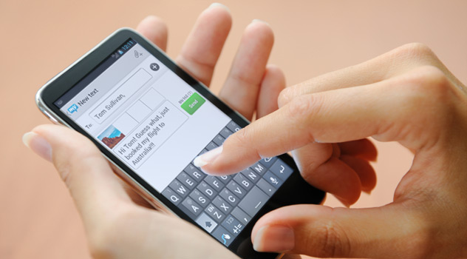
Step 3:
Through the phone call / sms / apps, the residents of the ward will be instructed to provide their family members with the home address.

Slide 6
Step 4:
At present, those who are unemployed in the wards have to be employed in the supply of essential goods.

Slide 7
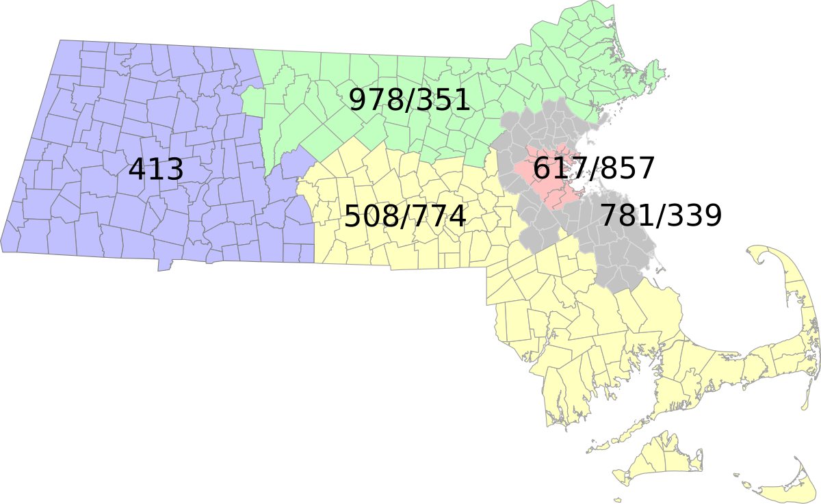
Step 5:
Each ward should select a few points based on the area.

Slide 8
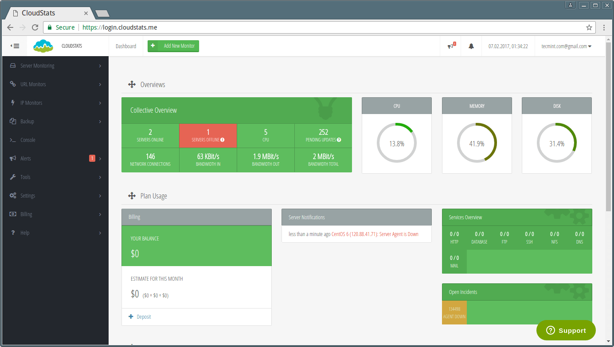
Step 6:
At each point, the Legislature will directly monitor the overall issues in coordination with the concerned public representatives.

Slide 9
Step 7:
The residents of the ward will provide the demand for the required material through phone call / sms / apps at the respective points.

Slide 10
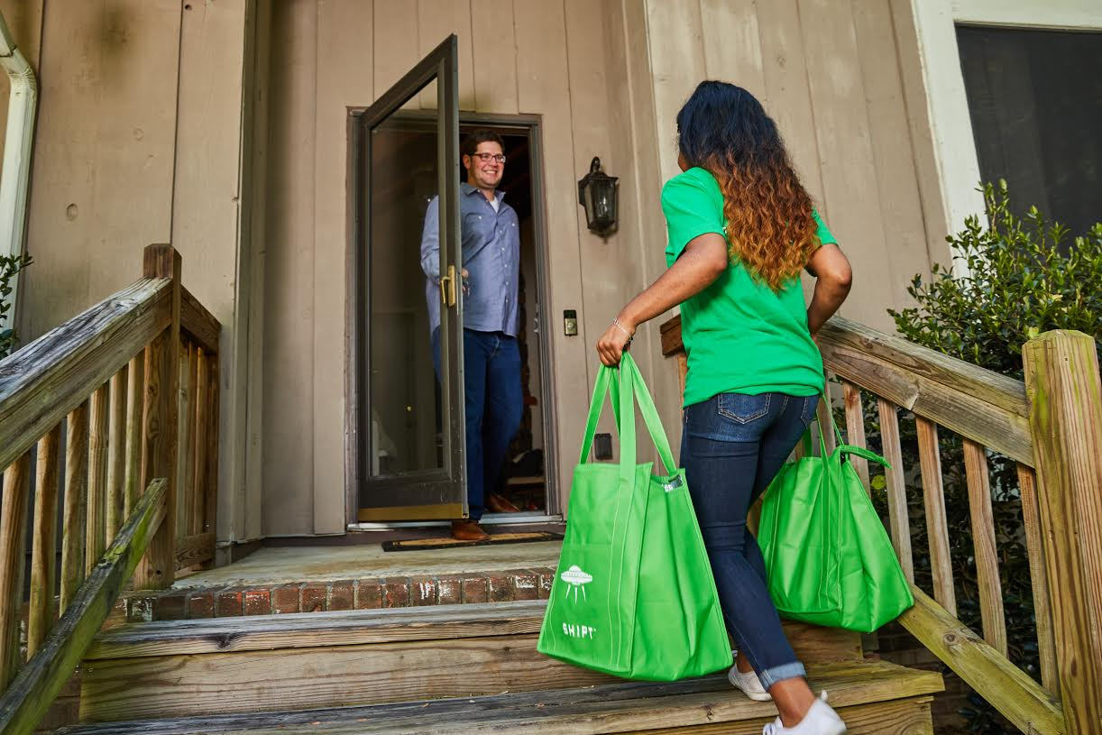
Step 8:
The employees in charge of the respective points will purchase the goods from the market as per the demand of the residents and deliver home delivery to the designated home.

Slide 11
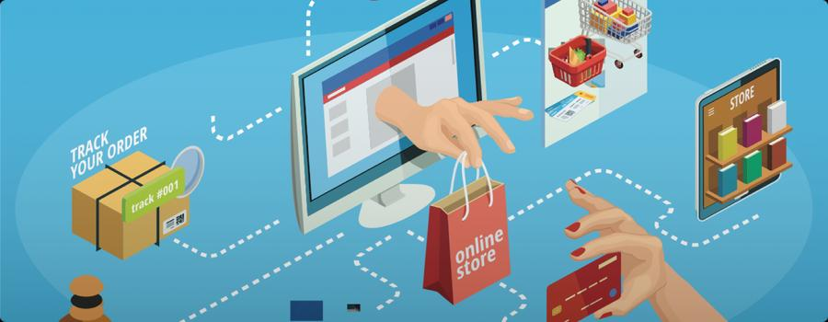
Step 9:
The law and order will always be overseen by all these activities. Then the confidence of the people will be assured.

Slide 12
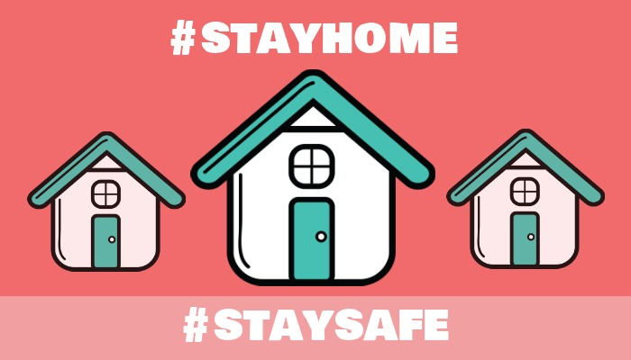
Step 10:
If the above steps can be implemented properly, then no person will be able to buy essential goods or go out without reason. As a result, proper implementation of the government's main objective, 'stay home, stay safe' will be possible.

Slide 13
Conclusion:
If the implementation of the steps mentioned in combating the Corona virus then it will be possible to implement the plan to keep people at home. Besides, unemployed people who are engaged in home delivery jobs will create employment opportunities and unemployment will be reduced. As well as 'Honorable Prime Minister' The dream of implementing digital Bangladesh will go a step further. I hope that by taking such steps, it will be possible to get rid of the pandemic 'corona virus' by keeping the people of Bangladesh in a safe distance.

Slide 14
For any further clarification on this proposal,
please contact –
Md. Abdullah Al Mahmud
Chief Exicutive Marketing Officer at JBD IT
E-mail: aalmahmud2015@gmail.com
Phone: +880 1747094999

